Slide 1

SpringBoot Application

Slide 2

SHOW

Slide 4
Contents
What’s SpringBoot?
Auto-configuration
Restful Api
unit-test

Slide 5
What is SpringBoot? Spring Boot makes it easy to create stand-alone, production-grade Spring based Applications that you can "just run"
Create stand-alone Spring applications
Embed Tomcat, Jetty or Undertow directly (no need to deploy WAR files)
Provide opinionated 'starter' dependencies to simplify your build configuration
Automatically configure Spring and 3rd party libraries whenever possible
Provide production-ready features such as metrics, health checks and externalized configuration
Absolutely no code generation and no requirement for XML configuration

Slide 6
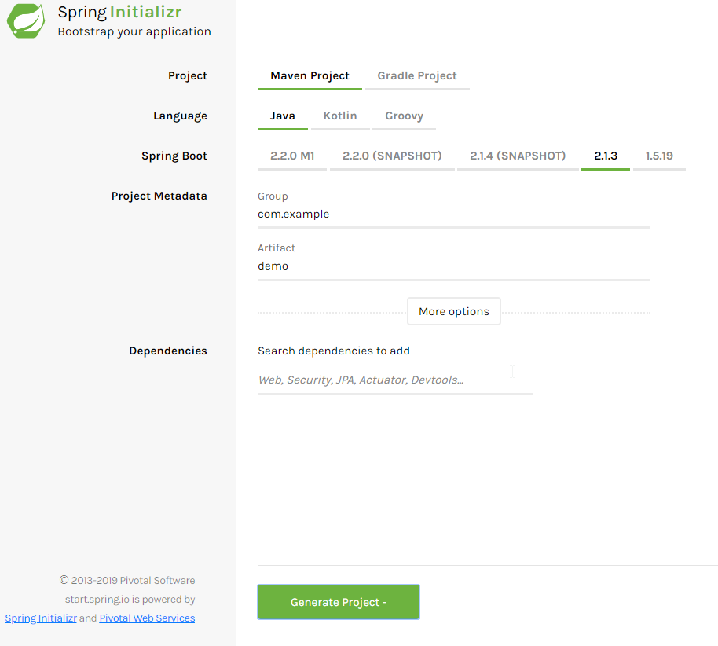
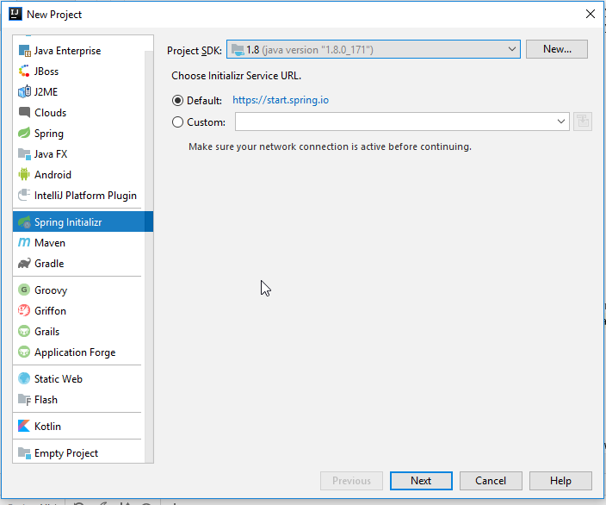
Quick Start

Slide 7
Automatically config
@EnableAutoConfiguration

Slide 8
REST (Representational State Transfer)
Resource: Resource,Data
Representational: representation: JSON, XML, JPEG, etc.;
State Transfer: State change. Implemented by HTTP verbs
Notes:
Resource：资源，即数据（前面说过网络的核心）。比如 books，friends等； Representational：某种表现形式，比如用JSON，XML，JPEG等； State Transfer：状态变化。通过HTTP动词实现。
REST 是一种针对网络应用的设计和开发方式。

Slide 9
URI (Universal Resource Identifier) CRUD
Create
POST
Read
GET
Update
PUT
PATCH
Delete
DELETE

Slide 10
Unit test
As the smallest component of a software system, unit tests have the following properties.
It is done by a programmer.
It has a detailed design description including input definitions, output definitions, and machining instructions.
It is an identifiable component of the visible program and is easily combined into a program. Can be compiled and tested separately.
Its size is relatively small and its logic is relatively simple.
Notes:
单元测试的意义
作为软件系统的最小组成单位，单元测试具有以下属性：
它是由一个程序员完成的。
它有一个详细的设计说明，包括输入定义、输出定义和加工说明。
它是一个可识别的看得见的程序组成部分，并容易被组合成程序。
能被单独地汇编和测试。
它的规模比较小，逻辑比较简单。

